Slide 1
Pipeline Creation on two different frames (Python + OpenCV) 1.Use Python Script with OpenCV library to perform below tasks – I . Create a Pipeline in order for the System to detect the Ego Lanes Automatically with one frame (Sample_02.jpg) attached in zip folder. II . Output of Intermediate stages of Pipeline would be required as mentioned below – Grayscale Gaussian Blur Canny Segment Hough Output Frame 2. Create a presentation with all the above Output frames mentioned in point no II and submit the Python script along with Presentation. The Output frames will be from OpenCV API (cv2.imshow()) not matplot lib.

Slide 2
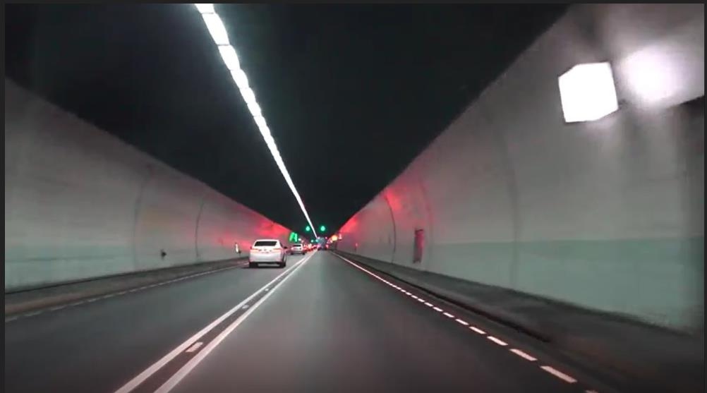
Task 1
Input Image

Slide 3
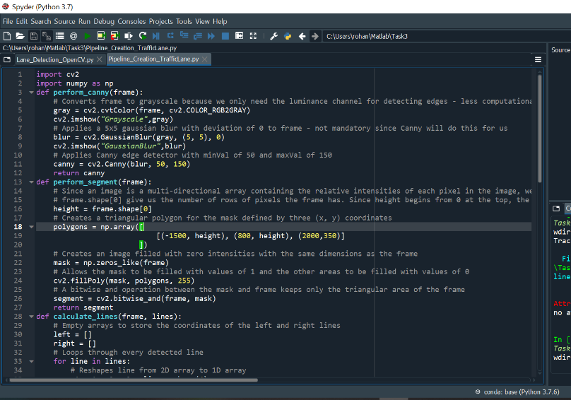
Task 1
Python Code-pg1

Slide 4
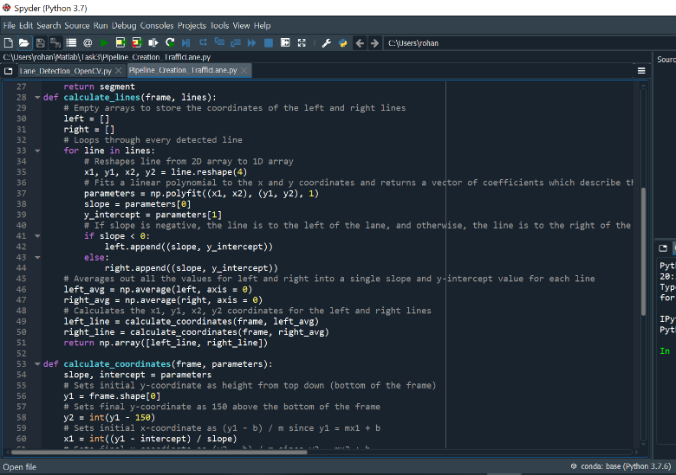
Task 1
Python Code-pg2

Slide 5
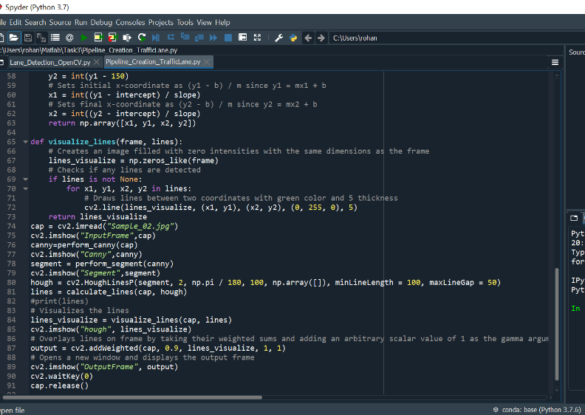
Task 1
Python Code-pg3

Slide 6
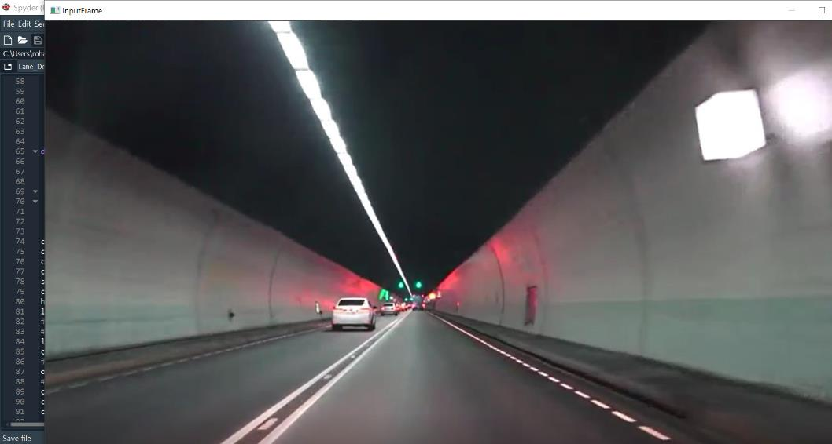
Task 1
Input Image

Slide 7
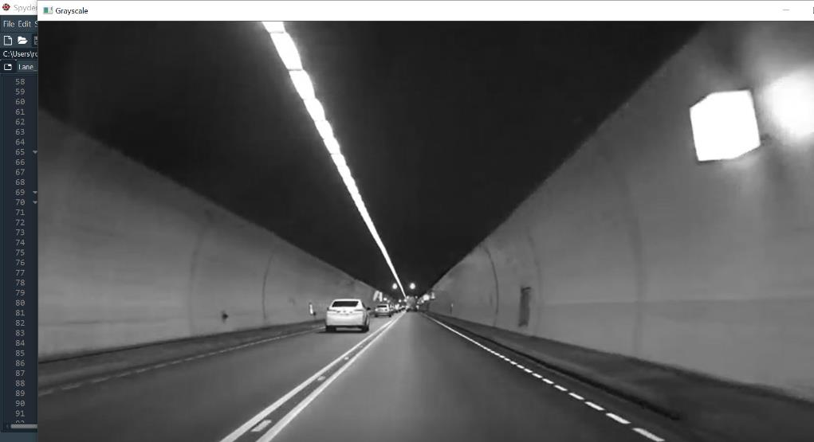
Task 1
Grayscale Plot

Slide 8
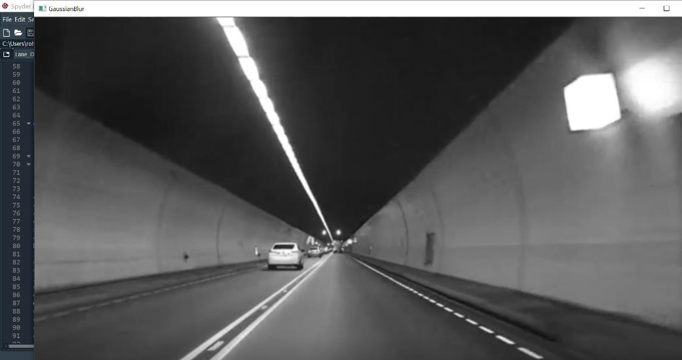
Task 1
Gaussian Blur

Slide 9
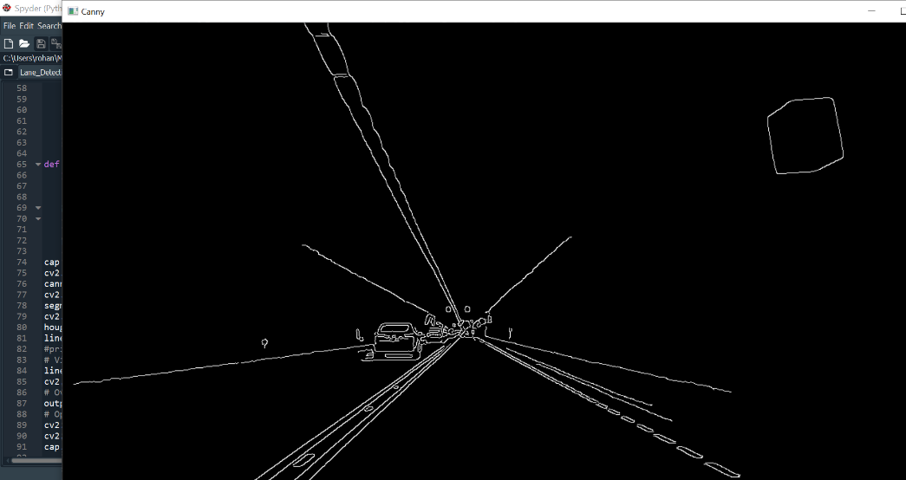
Task 1
Canny Plot

Slide 10
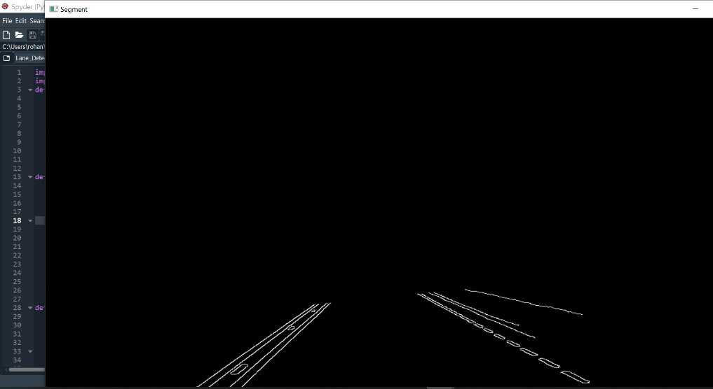
Task 1
Segment Plot

Slide 11
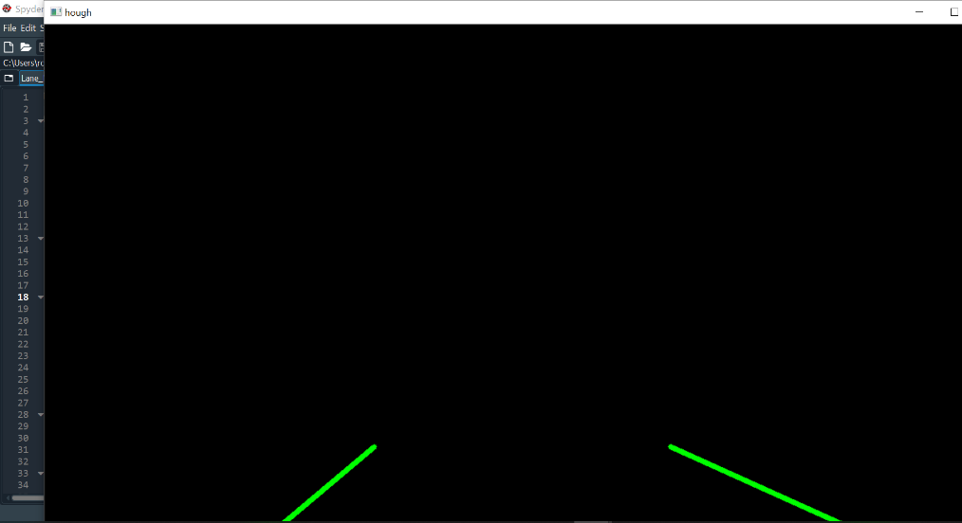
Task 1
Hough Plot

Slide 12
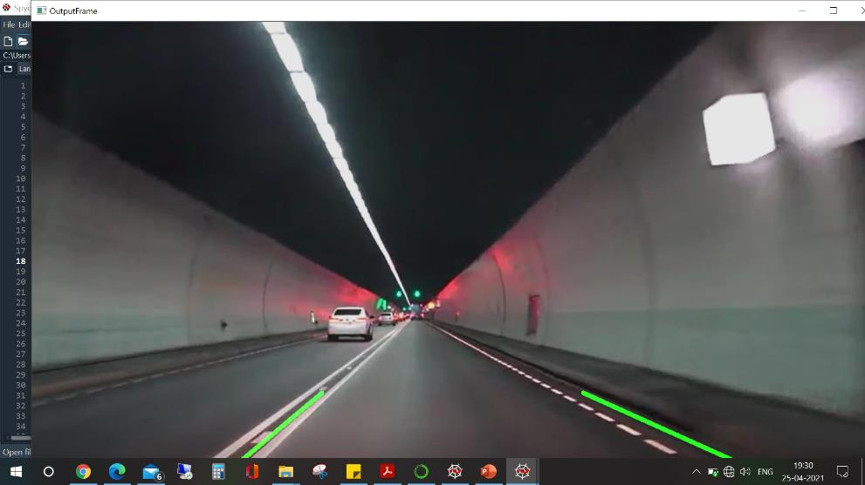
Task 1
Output Image

Slide 13
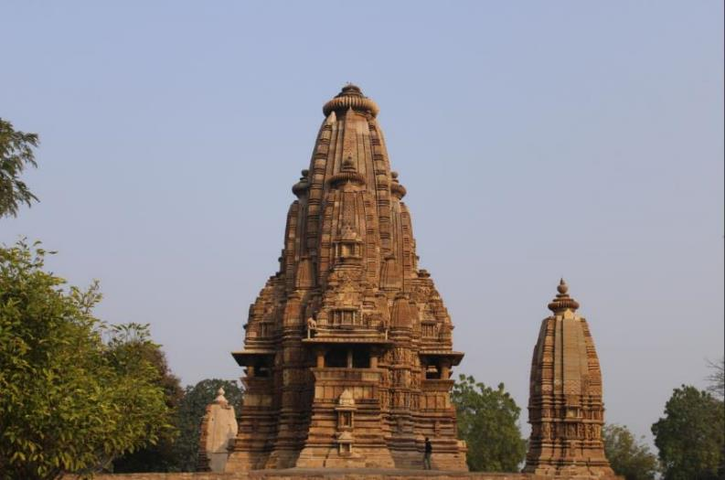
Task 2
Input Image

Slide 14
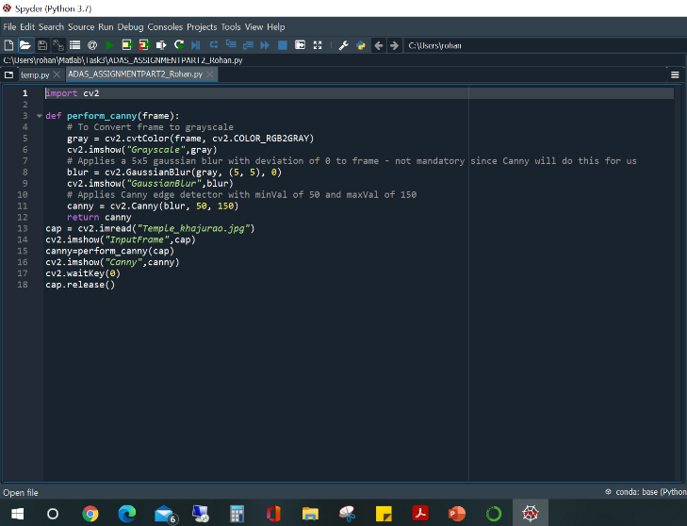
Task 2
Python Code-Spyder

Slide 15
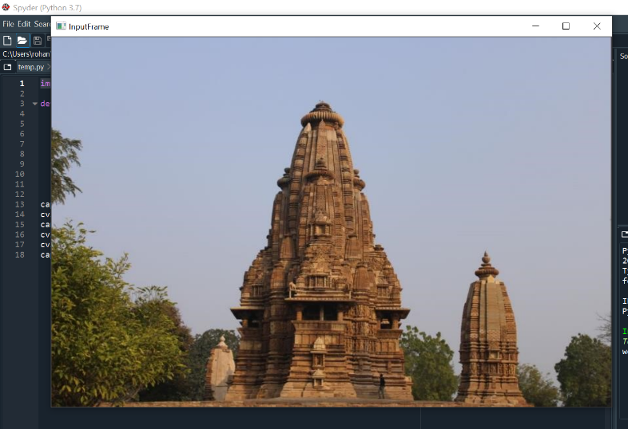
Task 2
Output-Input frame

Slide 16
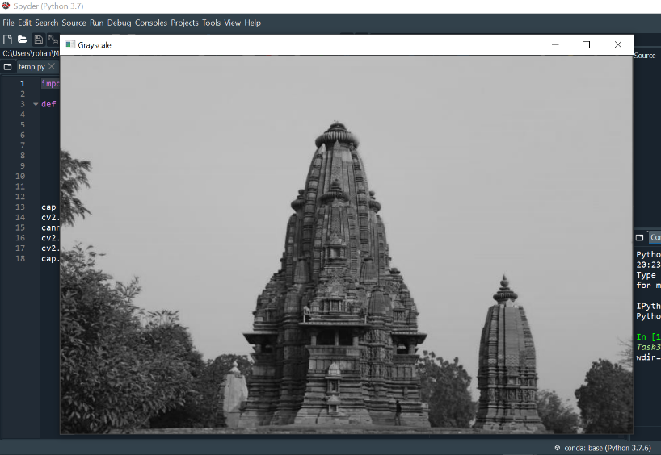
Task 2
Output-Grayscale

Slide 17
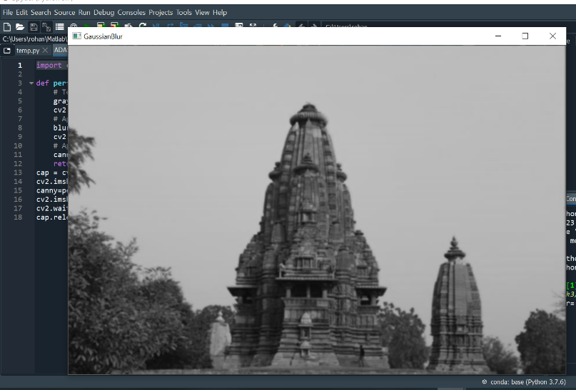
Task 2
Output-GaussianBlur

Slide 18
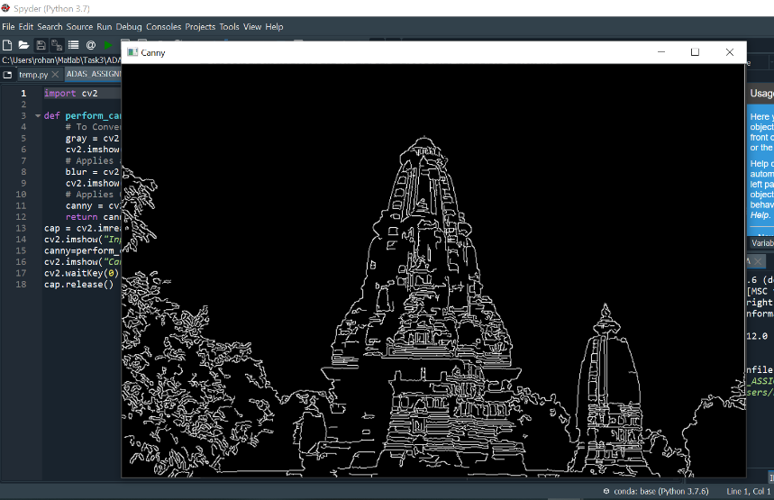
Task 2
Output- Canny

Slide 19
Task 2
THANK YOU

